Slide 1


English Research and Presentation Skills
English for Academic Purposes
EAP 701, EAP 801
Mongolian University of Science and Technology
Video #1:
Preparing What to Say and How to Say It

Slide 2
English Research and Presentation Skills
Video Series
For EAP 701, EAP 801
Presenter: Scott Poteet, English Language Fellow
Six Core Themes:
Giving presentations
Interviewing for a job
Reading strategies
Writing techniques
Doing research: finding sources, citing sources
Writing research style

Slide 3
Video #1: Presentation Skills
Preparing what to say
Introducing visuals
Reading numbers
Making contrasts
Describing results

Slide 4
Presentations
What is the best presentation you have heard? Why?
When have you given a presentation?
What’s the longest presentation you have given? The largest audience?
Is Power Point necessary for a good presentation?
What is very difficult about giving presentations for you?

Slide 5
What are good presentation skills?
Watch the video. What’s good and bad about the speech?
Notes:
Elicit examples

Slide 6


Slide 7
Effective Presentation Skills
Body Language
- Use your hands, smile
- Eye contact
- Consider moving around the room
Notes – use notecards, but don’t read them
Bus Driving
- Where/going, why, what will they see
- Be flexible to stop on the way

Slide 8
Effective Presentation Skills
The Audience
- be early and greet them
- Know their level, interest, and unique context
- connect with them: ask questions, have a story = memorable
- be relatable: be honest if nervous, enthusiastic about topic
- speak clearly and not too fast
- let them ask questions
Task and Experience
- Give the audience something to do, to discover, to experience

Slide 9
Power Point – Do’s and Don’ts
DO:
Use visuals, charts, pictures;
introduce a question to discuss before showing your thoughts;
Plan for no more than five key points;
Put key words and phrases on slides;
Use the ”Notes” feature to guide you;
Use the 10-20-30 PPT.
DON’T:
have too many words – reading replaces listening;
have very small text;
read your speech from slides.
Notes:
Elicit answers, 10 Slides, in 20 minutes, with size 30 font;

Slide 10
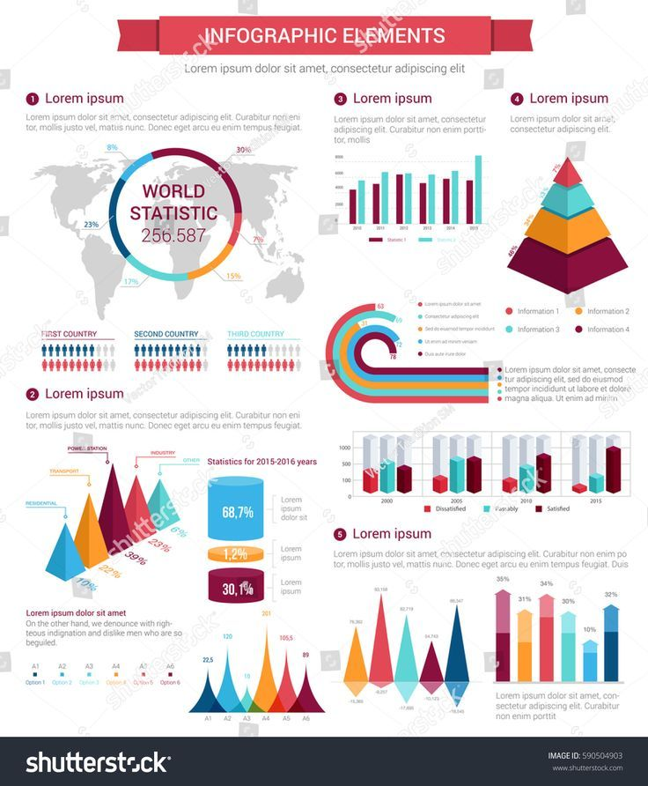

Introducing Visuals

Slide 11

Notes:
Why visuals?

Slide 12
Using Numbers in a Presentation
Give context. Don’t just read. What do the numbers mean?

Slide 13
Example:
Poor: Net profits amounted to 4 million dollars in the second quarter of 2016. Profits were 15 percent higher than in the first quarter.
Better: Net profits amounted to 4 million dollars in the second quarter of 2016. This is highest number for two years. Profits were 15 percent higher than in the first quarter. The increase in net profits resulted from two main factors: lower gasoline costs and higher profits from our new subsidiaries in the western region. While we're pleased with the results, we are still below our competitor's market share.

Slide 14
2. Read numbers correctly.
0,78 is 0.78 = 78% (English decimals)
Stress with two digits
xxxxTEEN vs. XXXXty
16 60
14 40
13% 30%
19,000 90,000
-18 -80

Slide 15
2. Reading numbers correctly: fractions.
1/2 - one half
1/3 – one third
1/4 – one fourth
1/5 – two fifth
1/6 – one sixth
1/7 - one seventh
1/8 – one eighth
1/9 – one ninth

Slide 16
2. Reading numbers correctly: fractions.
2/3 – two thirds
2/4 – two fourths
2/5 – two fifths
2/6 – two sixths
3/7 - three sevenths
5/8 – five eighths
8/9 – eight ninths

Slide 17
3. Reading numbers in a variety of forms.
50% = one half (to remember words)
0.78 = 78%
4,328 = over 4,300 (rounding)
3:4 = three to four (ratio)

Slide 18
4. Help the audience relate to the numbers.
Last year, the government exported 3,000,000 tonnes of coal.
Last year, the government exported 3,000,000 tonnes of coal. That is one ton of coal for every Mongolian.
You can help visualize numbers by using different types of scales such as distance, time, familiar places and things, to name a few.

Slide 19
Display the numbers: charts
Pie Chart: Good; don’t use if more than 5 six slices.
The percentages in the pie chart need to add to 100 percent. If the figures you're using are not proportions of some whole, you may not want to use a pie chart.
Bar Chart: better for a lot of categories.

Slide 20
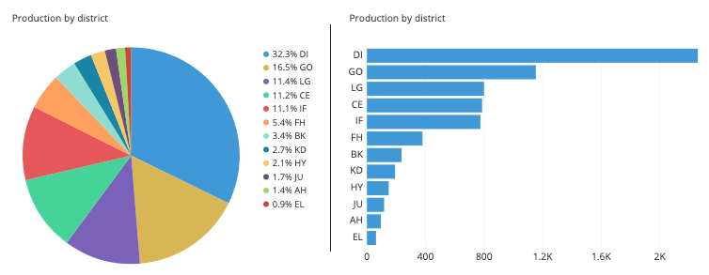
Preparing and Using Visual Aids

Slide 21
Review and Preview:
Qualities of a good presentation
Skills for preparing
How to read and use visuals and numbers
In Video #2 –
making contrasts, describing results

