Slide 1
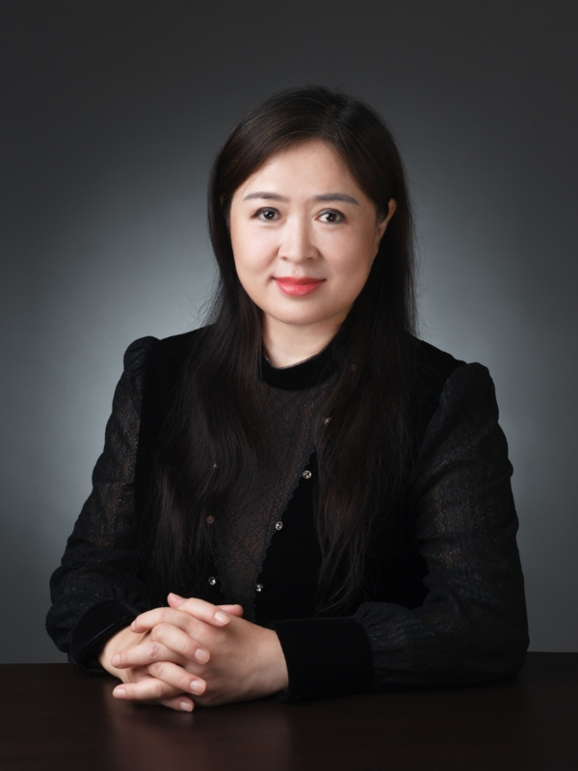
WANG YANLI
Modern and Contemporary Chinese Literature

